Slide 1
1. Practical Quantum Computing for Scientists

Slide 2
Lecture 1: Practical Quantum Computing
Quantum Computing and IBM Qiskit
Quantum Mechanisms for Computing
Quantum Algorithms and Applications
Hands-on Exercise on IBM Q.

Slide 3
Quantum Computing
A host of new computer technologies has emerged within the last few years, and quantum computing is arguably the technology requiring the greatest paradigm shift on the part of developers.
Quantum computers were proposed in the 1980s by Richard Feynman and Yuri Manin.
Quantum computers are here, the next big challenge: A quantum skills shortage. The quantum computing industry will be a $65 billion market by 2030; others anticipate that up to 20% of organizations could be budgeting for quantum computing in 2023, up from 1% in 2018 - Gartner

Slide 4
Quantum Computing
The foundational core of quantum computing is to store information in quantum states of matter and to use quantum gate operations to compute on that information, by harnessing and learning to "program" quantum interference.

Slide 5
Quantum Computing
Quantum Computing harnesses the laws of quantum mechanics to solve problems to complex for classical computers
Model the behavior of individual atoms in a molecule
Identify subtle patterns of fraud in financial transactions
Combinatorial problems (Travelling Salesman, Maximum Independent Vertex Set)
Process large data sets for AI and Data Science

Slide 6
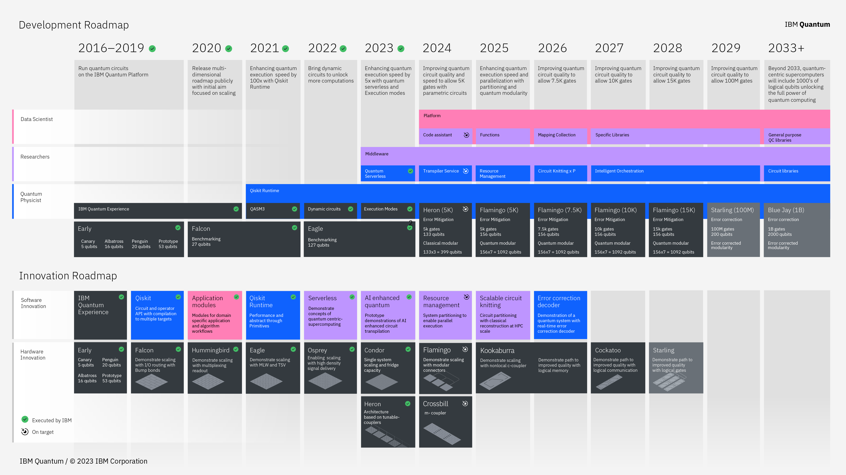
IBM Quantum Computing Roadmap

Slide 7
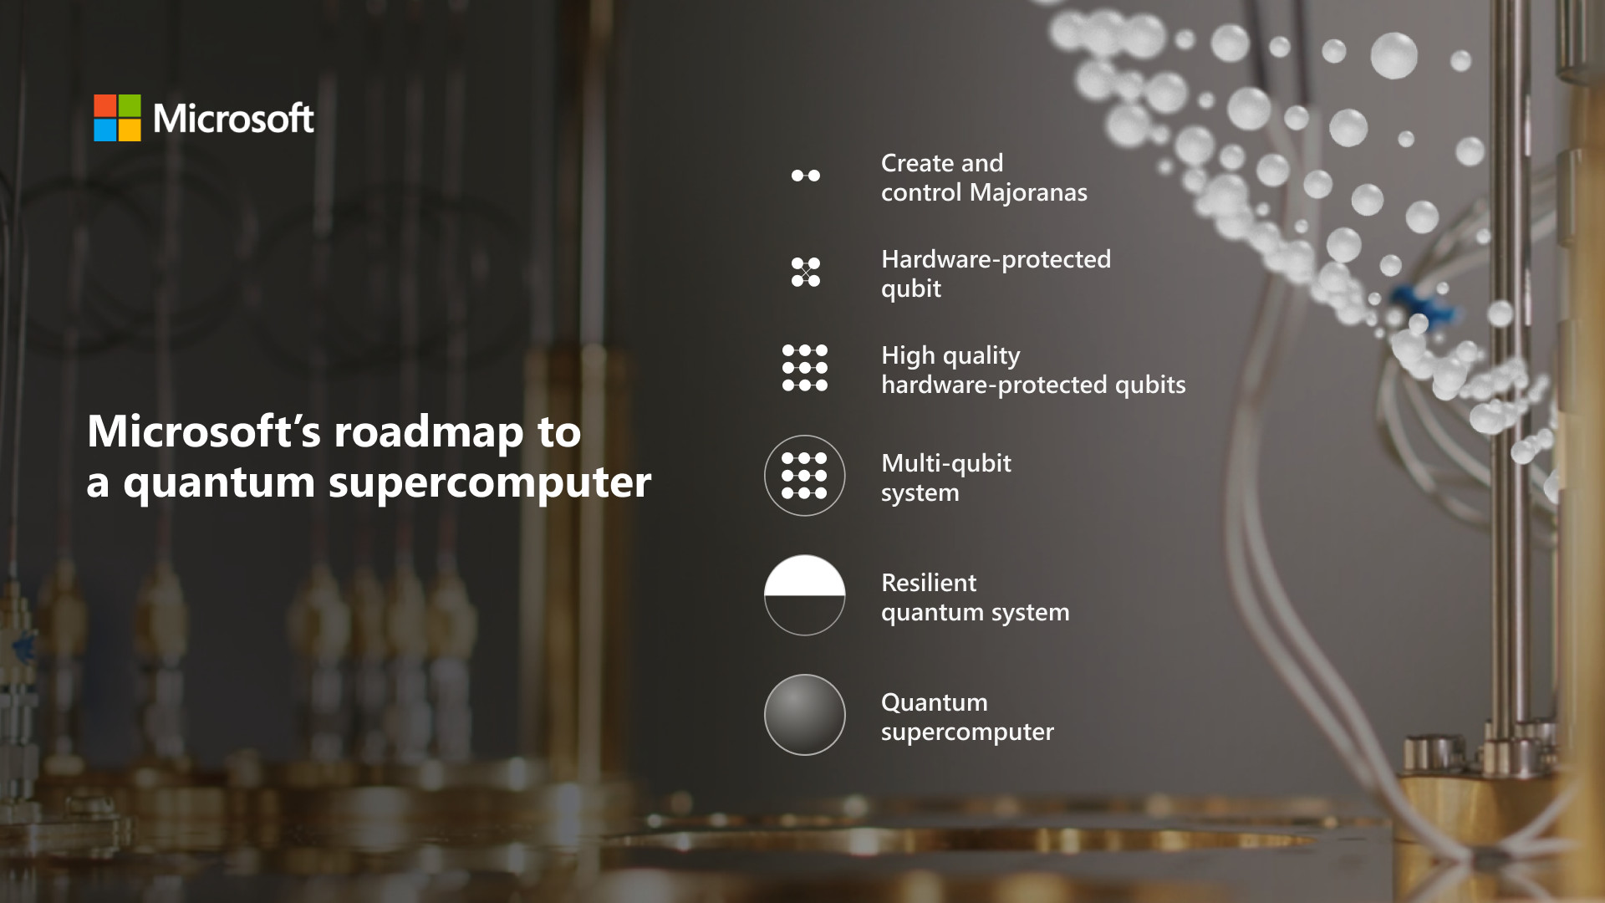
Microsoft Quantum Computing Roadmap

Slide 8
Quantum Computing Challenges
Many Challenges
Hardware Development
Developing high-quality quantum hardware, such as qubits and control electronics, is a major challenge.
Qubits are highly susceptible to noise and interference - decoherence
Error Correction
Most experts would consider this the biggest challenge. Quantum computers are extremely sensitive to noise and errors caused by interactions with their environment. This can cause errors to accumulate and degrade the quality of computation.
Quantum Software Development
Quantum algorithms and software development tools are still in their infancy, and there is a need for new programming languages, compilers, and optimization tools that can effectively utilize the power of quantum computers.
Scalability
Scaling up quantum computers to hundreds or thousands of qubits while maintaining high levels of coherence and low error rates remains a major challenge.
Others:
Classical computer interface
Standards and protocols
Trained Talent and workforce
Overall expense

Slide 9
Quantum Computing Modality
Quantum Computing harnesses the laws of quantum mechanics to solve problems to complex for classical computers
Superconducting qubits
IBM, Google, Rigetti, Oxford Quantum Circuits
Trapped-ion
IONQ, Quantinuum, Oxford Ionics (electronic control)
Neutral Atoms
QuEra, Pasqal, Infleqtion, Atom Computing,
Photonic
PsiQuantum, Quandela, Xanadu, QuiX, ORCA
Silicon Spin/Quantum Dots
Intel, diraq, Silicon Quantum Computing, Quantum Motion
Dimond NV (Nitrogen-vacancy) Center
Quantum Brilliance, Quantum Dimond Tech, Diatope

Slide 10
Quantum Computing Platforms
IBM Quantum (IBM Q system)
Microsoft Azure Quantum (Quantinum, IONQ, TOSHIBA, PASQAL, QCI, Rigetti)
Amazon Braket (IonQ, Rigetti, Xanadu, QuEra, Oxford Quantum Circuits, D-WAVE)
qBraid
Quandela Cloud
Qmware cloud
Oxford Quantum Circuits Private Cloud

Slide 11
Quantum Software SDK and IBM Qiskit
A tool for developing quantum algorithms for quantum computers or simulators and emulators
IBM Qiskit (Quantum Gate Model)
Google Cirq (Quantum Gate Model)
Microsoft Q## and QDK
Xanadu PennyLane
QuEra Bloqade (Neutral atoms)
Qmware basiq SDK
D-WAVE Ocean (Quantum Annealer)

Slide 12
Qubits
Basic Information Unit
A qubit (quantum bit) is the basic unit of information in quantum computing.
A qubit (or quantum bit) is the quantum mechanical analogue of a classical bit.
A general -pure- qubit state is expressed as: ψ=α∣0⟩+β∣1⟩
∣0⟩ and ∣1⟩ basis
α and β are the complex probability amplitudes

Slide 13
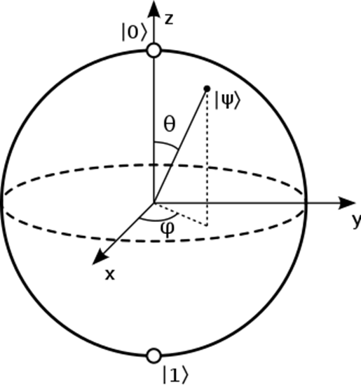
Qubit Representation
A single qubit by Bloch Sphere

Slide 14
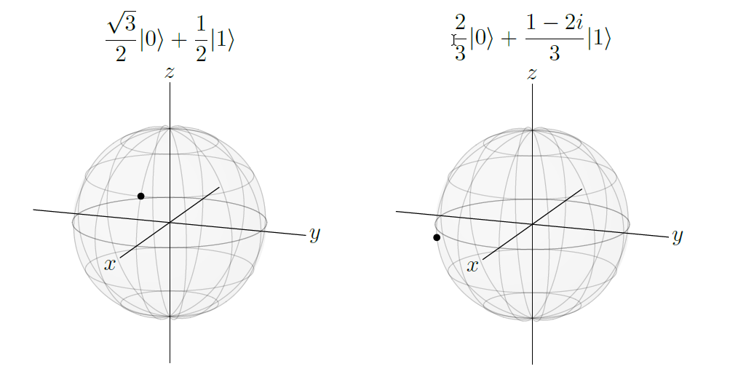
Measure Qubits
At end of a computation, we read (measure) the qubit
The qubit “collapse” to either |0> or |1> with some probability
Probability is the norm-square of each amplitude.

Slide 15
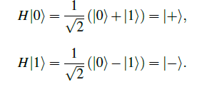
One-Qubit Quantum Gates
At end of a computation, we read (measure) the qubit
Identity Gate I
Pauli X gate
X|0⟩ = |1⟩,
X|1⟩ = |0⟩.
Pauli Y gate
Y|0⟩ = i|1⟩,
Y|1⟩ = −i|0⟩.
Pauli Z gate
Z|0⟩ = |0⟩,
Z|1⟩ = -|1⟩.
Phase Gate S
S|0⟩ = |0⟩,
S|1⟩ = i|1⟩.
Hadamard gate turns |0⟩ into |+⟩, and |1⟩ into |−⟩:

Slide 16
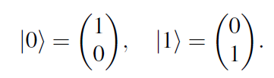
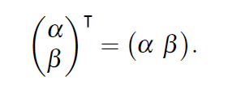
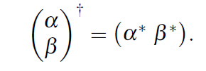
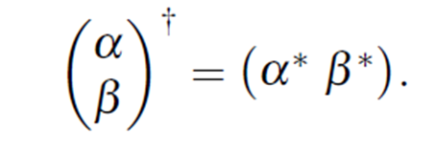

Linear Algebra for Quantum States and Gates
Column Vectors
Row Vectors
Bra ⟨ψ| =
Ket |ψ> =

Slide 17



Linear Algebra for Quantum States and Gates
Inner Products Are Scalars

Slide 18
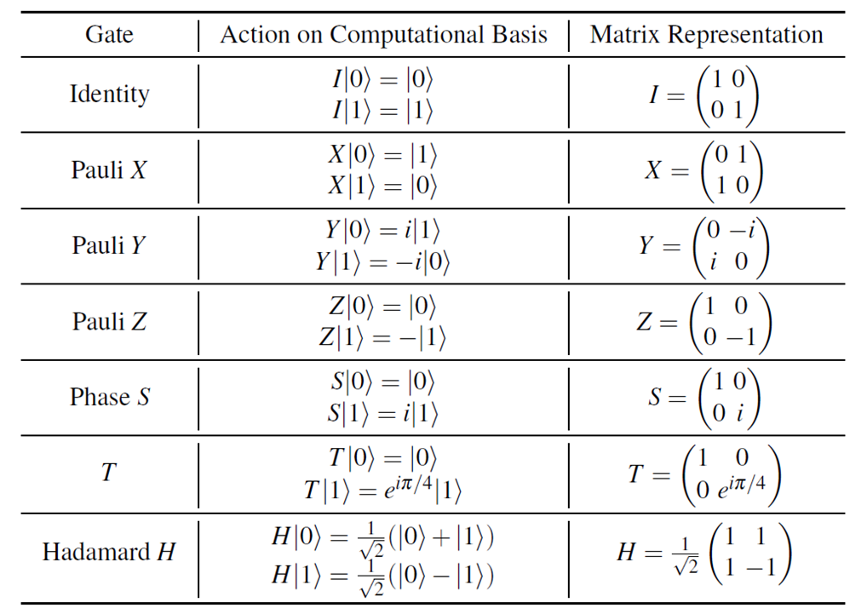
Gates as Matrices

Slide 19
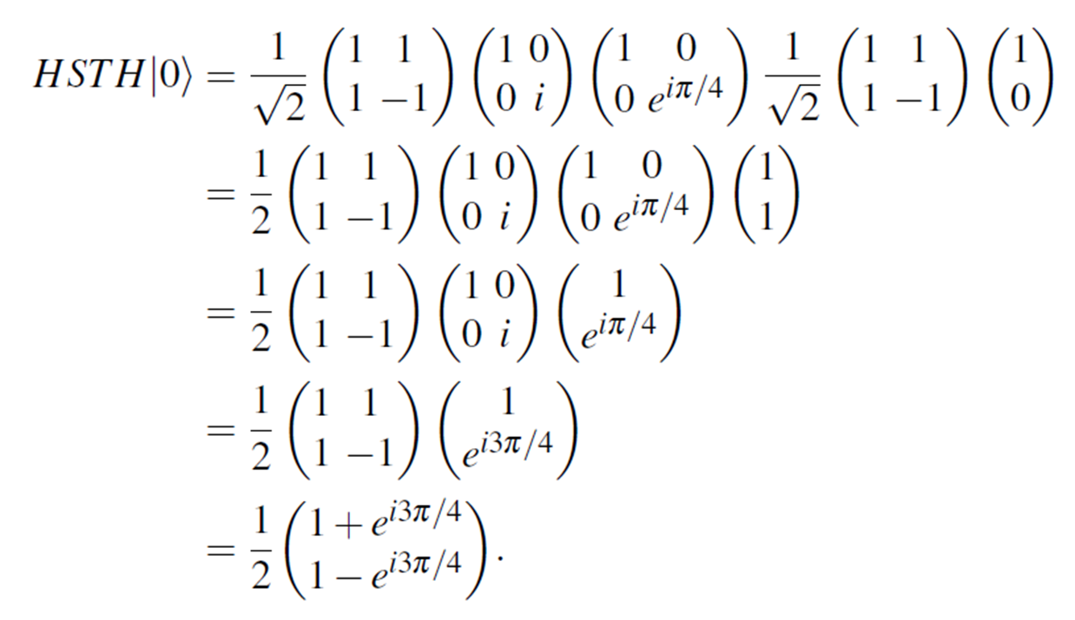
Quantum Gates Operations

Slide 20
Reversible Quantum Operation and Unitary Matrix
All Quantum Operations must be reversible
Quantum gates are unitary matrices, and unitary matrices are quantum gates.

Slide 21
Quantum Mechanism
Quantum Superposition
Quantum Entanglement
Quantum Interference

Slide 22
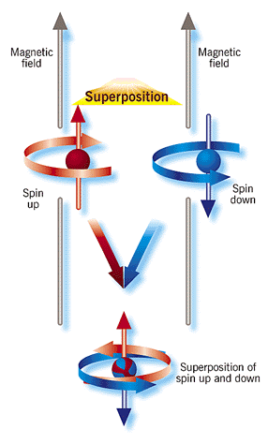
Quantum Superposition
Superposition is the ability of a quantum system to be in multiple states at the same time until it is measured.

Slide 23
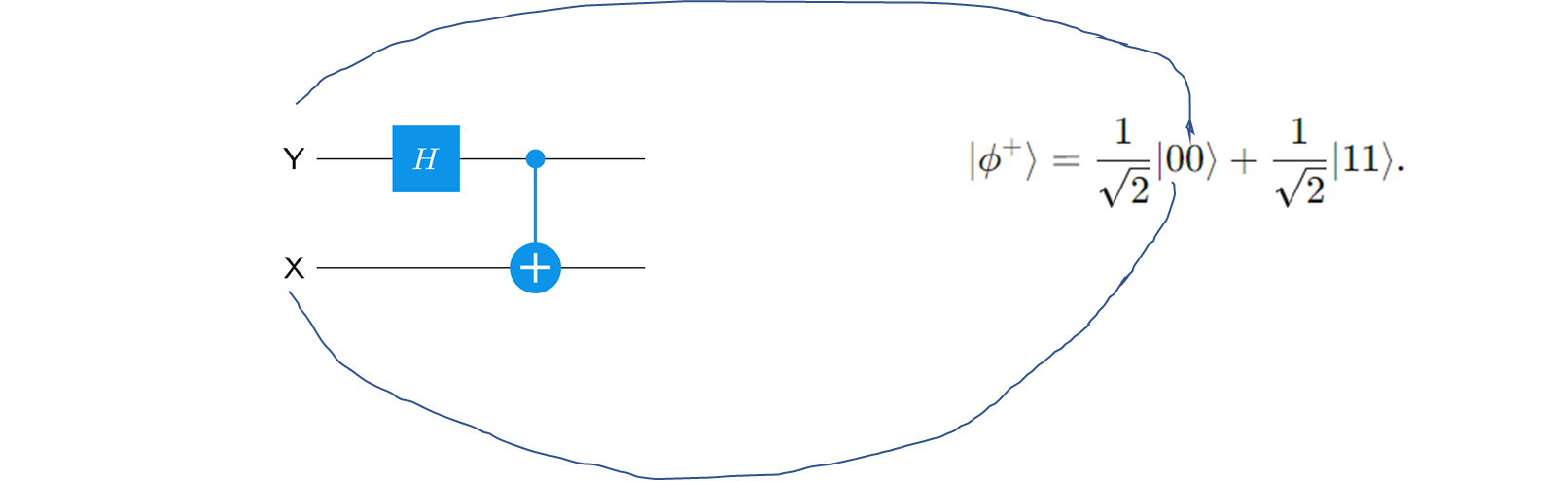
Quantum Entanglement
Quantum entanglement explains how two subatomic particles can be intimately linked to each other even if separated by billions of light-years of space. A change induced in one will affect the other, even if they are separated by a large distance.

Slide 24
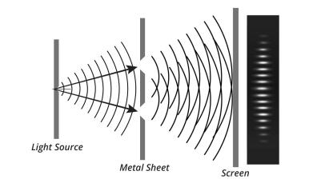
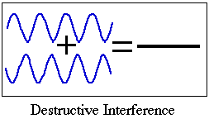
Quantum Interference
Superposition is the ability of a quantum system to be in multiple states at the same time until it is measured.
https://www.discovery.com/science/Double-Slit-Experiment

Slide 25
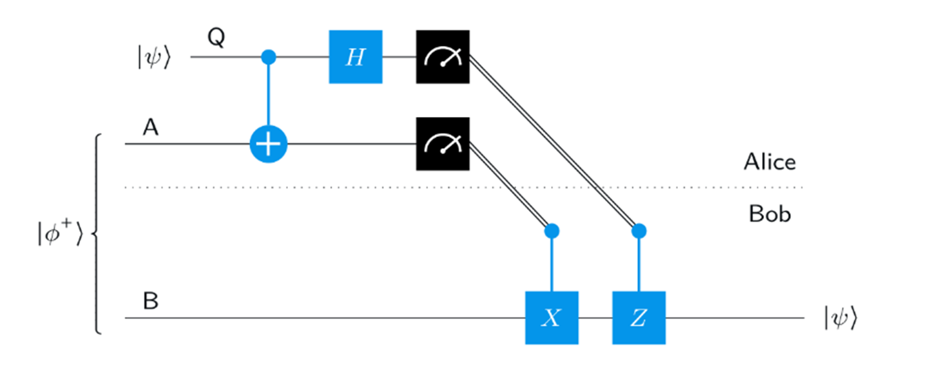
Quantum Applications and Protocols
Quantum Teleportation

Slide 26
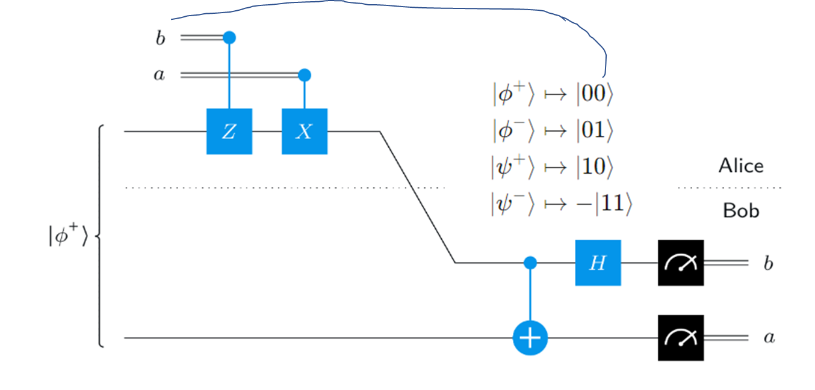
Quantum Applications and Protocols

Slide 27
Quantum Algorithms
A tool for developing quantum algorithms for quantum computers or simulators and emulators
Quantum Phase Kickback
Grover’s Algorithm
Phase Estimation
Shor’s Algorithm
Quantum Fourie Transform

Slide 28
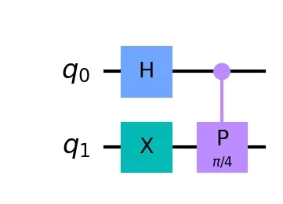
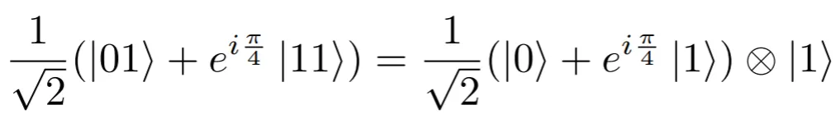
Quantum Phase Kickback
Quantum phase kickback is a quantum phenomenon that uses entanglement properties to transfer phase information from a target register to a control qubit. A vital role:
Grover’s Algorithm
The Phase Estimation
Shor’s Algorithm
Simon’s Algorithm
Deutsch-Jozsa algorithm

Slide 29
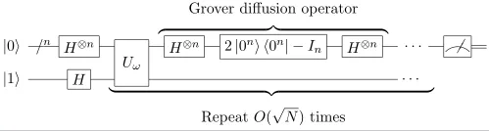
Grover’s Algorithm
solves one of the complex scenarios in the area of computing. It's the second major algorithm proposed for quantum computing. It solves the problem of searching through unstructured data. (1996)
Quadratical Speed up over classical algorithm

Slide 30
Shor’s Algorithm
finding the prime factors of an integer (1994)
Exponential Speedup to best known classical algorithm
With sufficient qubits and high quantum coherence, this algorithm can break public-key cryptography
RSA Scheme
Diffe-Hellman Key Exchange
Elliptic Curve Diffie-Hellman Key Exchange

Slide 31
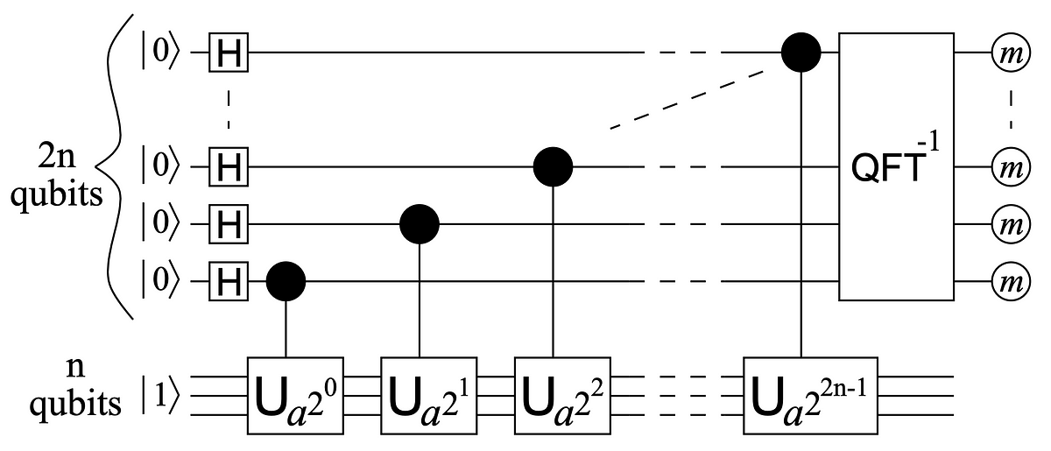
Shor’s Algorithm
turns the factoring problem into the problem of finding the period of a function, and may be implemented classically.
finds the period using the quantum Fourier transform, and is responsible for the quantum speedup.

Slide 32
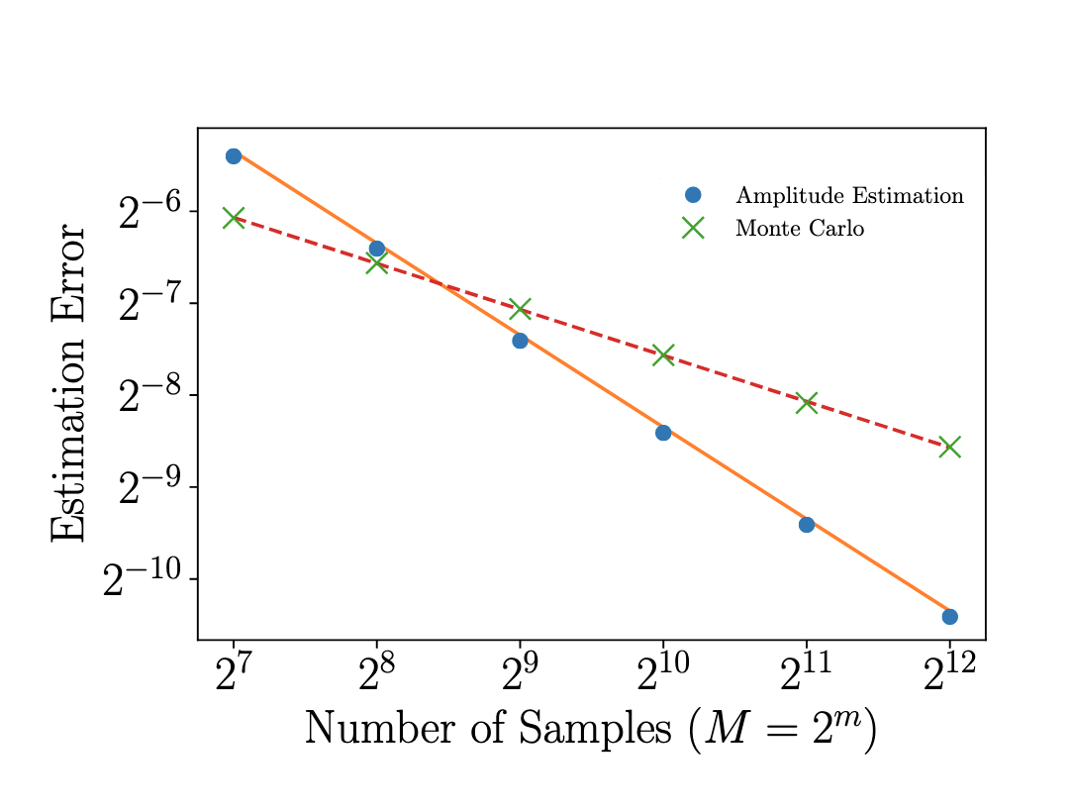
Quantum Speedups in Finance (Price Options)
Traditional Monte Carlo methods generally require extensive computational resources.
Quantum Mechanism: Amplitude Estimation, quadratic speed-up

Slide 33
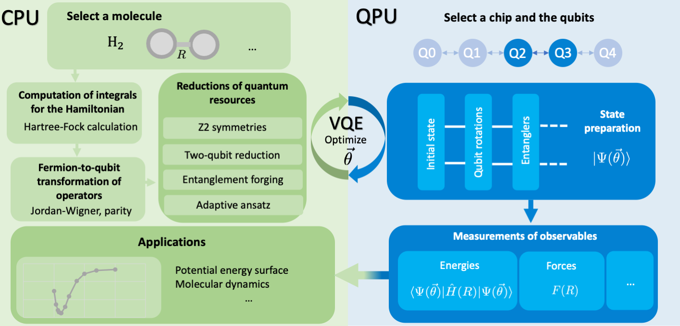
Quantum Chemistry Electronic Structure Calculations
Quantum computing holds promise to revolutionize high-performance computing and possesses enormous potential for transforming various fields beyond the current capabilities of classical computing. Quantum Approach: Variational Quantum Eigensolver (VQE) and quantum Equation of Motion to calculate H2O ground and excited state energies (Source: IBM Quantum)

Slide 34
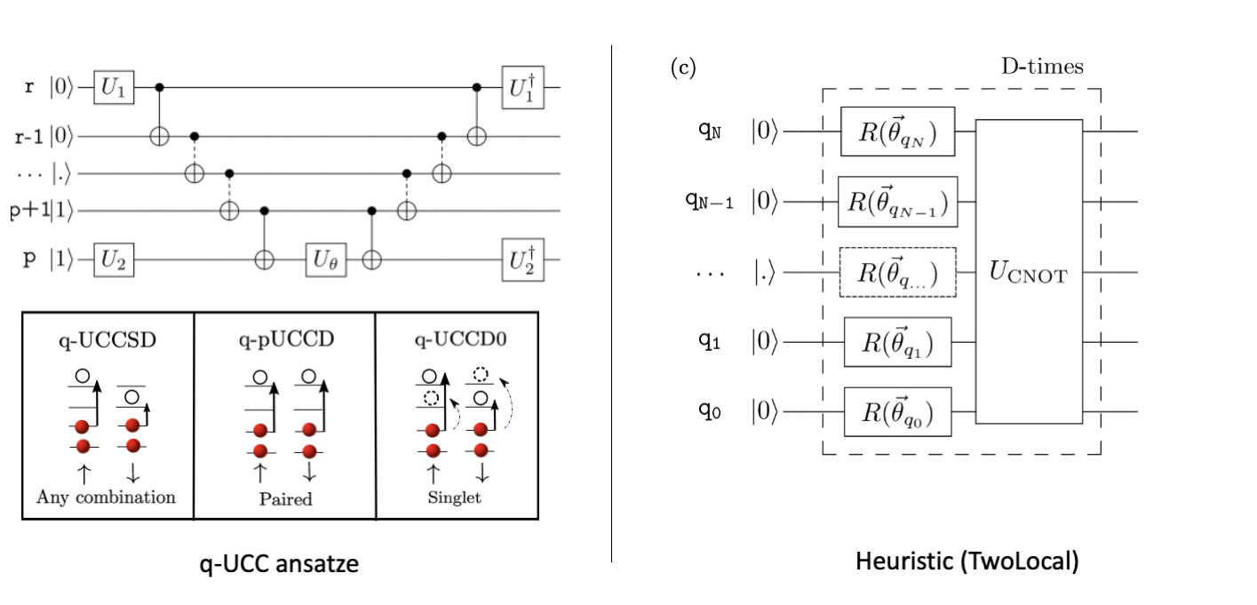
Quantum Chemistry Electronic Structure Calculations

Slide 35
Hands-on Quantum Chemistry Simulation
Quantum Chemistry Simulation, adapted from IBM Quantum Challenge Fall 2022
Use Quantum Computers to Explore Interstellar Space!
https://github.com/qiskit-community/ibm-quantum-challenge-fall-22
Note: This may not be compatible with the latest Qiskit 2.1.

